Slide 1
IMPLEMENTING THE
SALVADOR DECLARATION
The United Nations Programme Network of Crime Prevention and Criminal Justice Institutes (PNI)

Slide 2




Responding to the challenges of emerging forms of crime
Notes:
This presentation examines how the U.N. Programme Network Institutes – the PNI – can assist member States as they formulate ways to strengthen national crime prevention and criminal justice legislation, policies and practice in respect of emerging forms of crime.
The Salvador Declaration (OPs 13-15, 39-42) recognizes the increasing risk that transnational organized crime and illicit networks are evolving in new and different ways and the need for Member States to cooperate and share information in order to address these evolving transnational criminal threats.
Crimes come in traditional forms – fraud, theft and violent crimes affecting people or their property.
The exponential growth in information and communications technologies, the increasing use of the Internet and the increasing globalization of legitimate commerce has impacted the nature of crime and its globalization.
Some of these emerging forms of crime have a significant impact on the environment. Other new and emerging crimes include economic fraud and identity-related crime and their links to other criminal and, in some cases, terrorist activities. Cyber crime has been recognized as an emerging crime, and the Commission on Crime Prevention and Criminal Justice is convening an open-ended intergovernmental expert group to conduct a comprehensive study of the problem of cybercrime.
As we will see, the PNI have been working to address these and other issues. They have much to contribute as member States develop the needed legal responses to emerging crimes. We will review some of the steps member States will need to consider as they strive to strengthen their national crime prevention and criminal justice legislation, policies and practices in this area.

Slide 3




Organized Crime and New Illicit Networks
Increasing Risk of Convergence
Need for
International Cooperation
Threat Assessments
Programme on Counterfeiting
Training –
international
criminal justice and counter-terrorism
AsiaJust Programme
Notes:
Increasing risk of convergence
As UNODC has recognized in its global, regional and thematic threat assessments, transnational organized criminal groups continue to undermine the rule of law and further corruption in many parts of the world.
According to the UNODC 2010 global report, organized criminal groups impact or operate beyond borders and have expanded the range of illicit activities in which they participate. As we work to assess the nature and extent of transnational organized crime activities like trafficking in persons, smuggling of migrants and drug and firearms trafficking, we must also consider how these criminal activities further other criminal purposes like money laundering, environmental crimes or the commission of terrorist activities. How do organized crime activities and illicit networks converge and how do Member States organize themselves to respond to these threats?
The PNI contributes to the study and research of trends in transnational organized crime. For example, the International Scientific and Professional Advisory Council (ISPAC) has examined the impact of organized crime activities in the context of the illegal trade in cultural properties, particularly art and antiquities (at its annual conference in Courmayeur, Italy in 2008), and the convergence of international crime and terrorism in 2002 and published reports on these conferences.
The Australian Institute of Criminology is doing research that addresses cybercrime threats, including the intersection between corruption and cybercrime and the threat posed by cloud computing and the virtual world. UNICRI’s Programme on Counterfeiting maps the involvement of organised crime in counterfeiting, conducts research on the counterfeiting of medicine and identifies risks for consumers.
The Need for international Cooperation
The Salvador Declaration reiterated the need for international cooperation to address transnational crimes. The PNI work with Member States to enhance their capacity in this area. For example, the Institute of Security Studies’ International Crime in Africa Programme provides specialised training aimed at capacity building and technical assistance on issues of international crime, counter-terrorism and transnational threats. Requesting states in Africa (Botswana, Kenya, South Africa, Tanzania & Uganda) have sought to enhance the domestic capacity of their prosecutors, judges, lawyers and investigators to respond to such crimes.
This complements efforts by UNODC in its Counter-Terrorism Capacity Building work. Recognizing the growing links between crimes such as organized crime, drugs, trafficking of illicit goods and terrorism, UNODC’s Terrorism Prevention Branch (TPB) focuses particularly on those criminal justice officials involved in the investigation, prosecution and adjudication of terrorism cases. The TPB works towards strengthening their capacity to implement counter-terrorism legislation in accordance with international standards and obligations as defined by the relevant conventions and protocols, General Assembly and Security Council's resolutions. UNODC/TPB has extended its reach to executive officials and legislators whose support is necessary to ensure the ratification of international legal instruments against terrorism and the enactment of implementing legislation. Focused training initiatives on technical issues related to these thematic fields are supported by technical publications and tools. UNODC/TPB also offers assistance for the ratification and legislative incorporation of the international legal instruments as well as facilitating regional networking, joint training, and confidence building initiatives.
The Korean Institute of Criminology and the UNODC Regional Centre for East Asia and Pacific are working jointly to establish a regional framework to address transnational organized crime. AsiaJust’s focus is to enable Member States to ratify international conventions and instruments relating to drugs, crime and terrorism and to develop the domestic legislative and regulatory frameworks to establish a criminal justice system that is able to address the needs of vulnerable groups and to improve transnational cooperation on criminal justice matters.
AsiaJust has facilitated the Korea-ASEAN High Level Prosecutors Meetings (2010) and the Asia & Pacific Regional Workshop on Cybercrime (2011) jointly organized by KIC and UNODC to enable cybercrime experts and prosecutors to exchange practical perspectives on cybercrime. A Prosecutors' Exchange Programme between Korea and ASEAN Member States is currently being established and in 2011, A Comparative Study on the Prosecutorial Systems of ASEAN Member States was published.

Slide 4
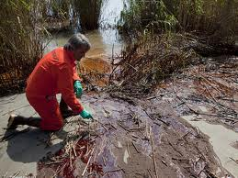

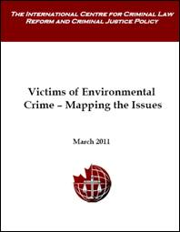

Emerging Crimes Impacting the Environment
What is happening?
Who is affected?
What can we do?
  CBRN Centres of Excellence Initiative
Notes:
Increasingly we recognize the impact crime has on the environment. UNICRI is researching the nature and extent of the illicit trafficking and dumping of toxic and e-waste. The exploitation of natural resources is linked to conflicts in many parts of the world and the commission of serious international crimes like crimes against humanity and war crimes.
Environmental crime is often perceived as “victimless” crimes. Some environmental crimes (the illegal dumping of chemicals into water resources) do not always produce an immediate consequence. The harm may be diffused or go undetected for a lengthy period of time. The victims are not always aware of the fact that they have been victimized or know who has victimized them.
As well, many environmental disruptions are legal and take place with the consent of society, particularly where the environmental degradation provides much needed employment. Little attention has been paid to this type of victimization. The International Centre fro Criminal Law and Criminal Justice Policy has developed a research paper that contributes to this debate and maps out issues relating to victims of environmental crime and identifies topics for further study
What can we do? States have begun to work together in practical ways to address crimes that may impact the environment. UNICRI – the United Nations Interregional Crime and Justice Research Institute, is working with the European Union to establish CBRN Centers of Excellence. They are identifying national focal points in partner countries, developing regional centres to share best practices amongst Member States in the Network and to identify, collect and deploy resources efficiently in addressing the threat of chemical, biological, radiological and nuclear materials and weapons. CBRN proliferation, theft, sabotage and illicit trafficking are all areas of serious concern. As well, CBRN accidents can pose threats such as natural and industrial catastrophes, incorrect waste management and transportation accidents. The initiative aims to develop CBRN guidelines for improving National CBRN Policies and to carry out specific projects that address these threats.
Note: The countries and regions of focus are: “African Atlantic Façade; Middle East; North Africa; South East Asia; South East Europe, the Caucasus, Ukraine and Moldova; Central Asia; Sub-Saharan Africa and Gulf Cooperation Council”.
Salvador Declaration, OP 14:
14. We acknowledge the challenge posed by emerging forms of crime that have a significant impact on the environment. We encourage Member States to strengthen their national crime prevention and criminal justice legislation, policies and practices in this area. We invite Member States to enhance international cooperation, technical assistance and the sharing of best practices in this area. We invite the Commission on Crime Prevention and Criminal Justice, in coordination with the relevant United Nations bodies, to study the nature of the challenge and ways to deal with it effectively.

Slide 5
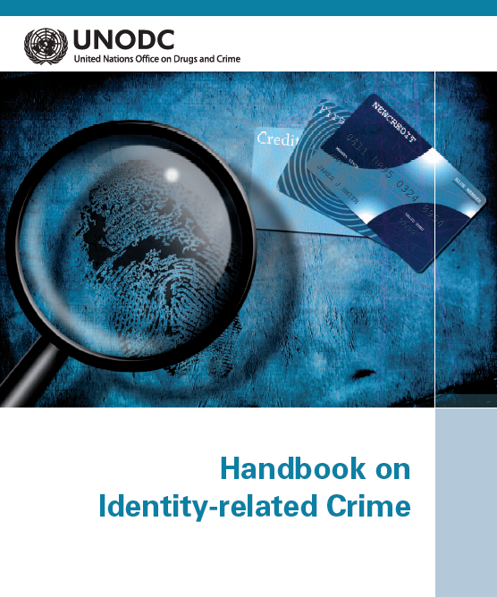
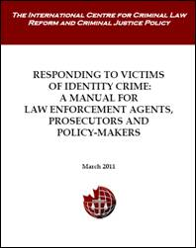
Addressing Economic Fraud and Identity-Related Crime
Research
Prevention, Prosecution and International Cooperation
Support to the UN Expert Group on Economic Fraud and ID Related Crime
Notes:
In the Salvador Declaration, states recognize the challenge posed by economic fraud and identity-related crime and their links to other criminal and, in some cases, terrorist activities. Member States were invited to take appropriate legal measures to prevent, prosecute and punish economic fraud and identity-related crime, to support UNODC work in this area and to exchange relevant information and best practices.
UNODC and the UN Expert Group on Economic Fraud and Identity Related Crime have devoted considerable resources to identifying how economic fraud and identity related crime arises, what Member States can do to prevent and prosecute economic fraud and identity related crime and to assist Member States to work together to tackle these issues.
ISPAC held an international conference on the evolving nature of identity-related crime and published a volume of proceedings in 2008. The Australian Institute of Criminology has conducted research, for example, on the impact of the global financial crisis on fraud.
With respect to prevention and prosecution, the International Centre for Criminal Law Reform and Criminal Justice Policy has supported the work of the UN Expert Group on victims issues and developed a manual to assist domestic law enforcement, prosecutors and policy-makers to respond effectively to victims of identity related crime, with a view to reducing the impact and incidence of such crime. The manual includes seven modules and several printable appendices for use by police officers and investigators in their daily operations. While directed to Canadian law enforcement and prosecution authorities, it may provide a useful template for other states dealing with victims of identity related crime.

Slide 6



Fighting Technology-related Crime
African Centre for Cyberlaw and Cybercrime Prevention
“Digital Criminal Guide for Cyber terrorism Crime
Virtual Forum on Cybercrime
Human Rights and Cybercrime projects
Notes:
The exponential growth of the Internet has created opportunities to exploit the vulnerable, particularly children, on the Internet, to commit traditional crime via new media of communication and develop new forms of crime.
Early ISPAC Conferences in 2003 and 2004 assisted Member States to explore the contours of technology related crime. ISPAC then focused its attention on identity related crime and more recently on protecting children from sexual predators on the internet.
ISPAC Conferences
International Conference on “Crime and Technology”, Courmayeur Mont Blanc, Italy, 28-30 November 2003
Publication, Crime and Technology: New Frontiers for Legislation, Law Enforcement and Research, edited by Ernesto U. Savona, Springer, 2004
International Conference on “Protecting children from sexual offenders in the information technology era”, Courmayeur Mont Blanc, Italy, 11-13 December 2009
International Conference on “Cybercrime: Global Phenomenon and its Challenges”, Courmayeur Mont Blanc, Italy, 2-4 December 2011
As we know, cybercrime does not respect borders. It is not confined to one region of the world. The African Centre for Cyberlaw and Cybercrime Prevention was established to examine the impact of cybercrime on the African continent. More specifically, in 2011, UNAFRI assisted Member States in the region by increasing awareness of identity theft and by capacity building. ACCP conducted East African Economic and Hi-Tech Crime Forum 2011/Sensitisation Workshop to Cybercrime Law; in Kampala, July 2011 and in Cape Town, South Africa, November 2011.
In Asian, the Korean Institute of Criminology established a Virtual Forum against Cybercrime. This online training program for law enforcement/ judicial personnel provides lectures on investigative technologies on cybercrime. It aims to strategically improve institutional ability against the global phenomenon of cybercrime AND also to provide information and researches on cybercrime for general public. It delivers technical assistance and training for cybercrime investigators especially for the developing countries, builds a research network and serves as clearinghouse of resources for experts/scholars from around the world to both benefit and contribute to most current cybercrime research.
The fight against cybercrime must also consider the human rights implications of the criminal response to cybercrime. After 9/11 and the terrorist bombings in Madrid (11 March 2004) and London (07 July 2005), policing and intelligence activity have increasingly focused on preventing future attacks and not just identifying the perpetrators of offences already committed.
Preventive police work includes the use of detection technologies. These range from CCTV camera-surveillance of suspicious behaviour in public places to secret Internet monitoring and data-mining. Such technologies raise ethical and legal issues (notably issues of privacy) that must be confronted against the background of the legal and ethical issues raised by counter-terrorism in general. As states implement counter-terrorism initiatives, they must consider pre-existing legal commitments on the part of the same governments to safeguard freedom of association, free expression and privacy. The Raoul Wallenberg Institute is involved in a research project that deals with detections technologies and the implications such technologies may have on ethics and human rights. Research papers have been produced that raise questions for policy-makers in these areas.

Slide 7
Contribution of the PNI
Identification of new trends / emerging crimes
Research
Development of Toolkits, Manuals and other forms of technical assistance and training
Collaboration with UNODC and Member States
Notes:
At the outset, I mentioned the various ways the PNI can assist Member States.
- We can identify new trends / emerging crimes.
- Research is available.
- A variety of toolkits, manuals and other forms of technical assistance and training have been created and various PNI members stand ready to work with representatives of Member States and UNODC in furthering the objectives of the Salvador Declaration, in particular to strengthen the national crime prevention and criminal justice legislation, policies and practices and to enhance international cooperation, technical assistance and the sharing of best practices in the responding to the challenges of emerging forms of crime.

Slide 8
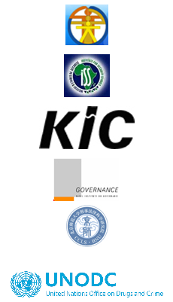
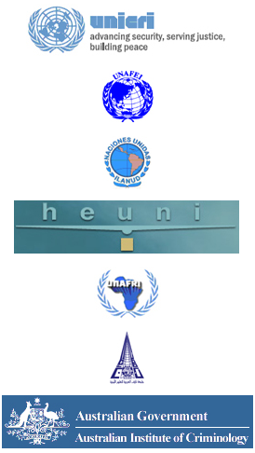
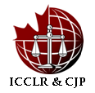
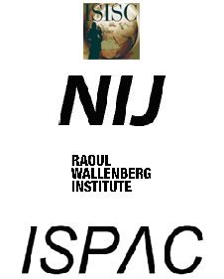
Resources
For links to the various PNI institutes, see
http://www.unodc.org/unodc/en/commissions/CCPCJ/institutes.html

