Slide 1

Strengthening the Response of the
Criminal Justice System on the
National and International Level: Good Practice
Hyun Wook CHUN, Ph.D. in Law
Associate Research Fellow
Korean Institute of Criminology

Slide 2
Act on the Protection and Management of Wild Fauna and Flora
Definition of “Endangered Wild Fauna and Flora” (Korean Law)
  Level 1 Species in danger of extinction which have decreased in number significantly
  Level 2 Species which may be in danger of extinction if risk factors are not eliminated or alleviated
  * Based on wild fauna and flora inhabiting in Korea
  International Endangered Species Species prohibited from international trade under CITES (including Appendix I, II, III)
Total | Category | Mammal | Bird | Reptile | Amphibian | Fish | Invertebrate | Land plant | Marine plant
221 | 1+2 | 22 | 61 | 4 | 2 | 18 | 29 | 64 | 1
50 | Level 1 | 12 | 13 | 1 | - | 6 | 5 | 8 | -
171 | Level 2 | 10 | 48 | 3 | 2 | 12 | 24 | 56 | 1

Slide 3
Continued
Article 14 Prohibition of Poaching and Collecting of Endangered Wild Fauna and Flora
Article 16 Prohibition of International Trade of Endangered Species
Articles 67-69 Penalty
Article 57 Reward for Reporting and Arresting
  To promote reporting because there are no direct victims or those victimized do not take legal actions
Article | Penalty | Poaching, Collection, Defoliation | Distribution, Storage, Import, Export | Brokerage, Purchase, Sale
Article 67 | ·Imprisonment up to 5 years ·Fine up to USD 30,000 | Level I
Article 68 | ·Imprisonment up to 3 years ·Fine up to USD 20,000 | Level II | Level I, International endangered species
Article 69 | ·Imprisonment up to 2 years ·Fine up to USD 10,000 |  | Level II | International endangered species

Slide 4
National Case: South Korean Supreme Court Orders Theme Park to Free Its Dolphins
Pacific Land, a dolphinarium in Jeju Island, is ordered by South Korean Supreme Court to return its dolphins to the ocean (April 2013)
Tursiops aduncus (Indo-Pacific Bottlenose Dolphin)
  Does not constitute Level I or Level II species but an international endangered species
Timeline of Events
  2009 - 2011 Pacific Land makes illegal purchase of 11 dolphins
  November 2012 District Court makes ruling and defendant appeals
  March 2013 Supreme Court confirms original ruling
  April 2013 Confiscated dolphins to receive training before release
  June/July 2013 Release of dolphins into the ocean

Slide 5
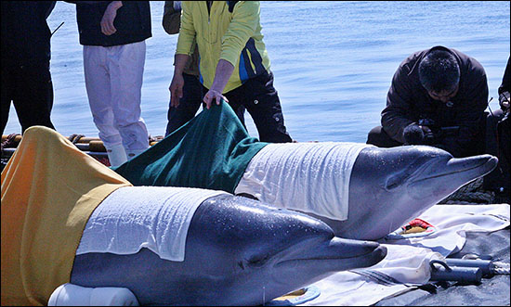
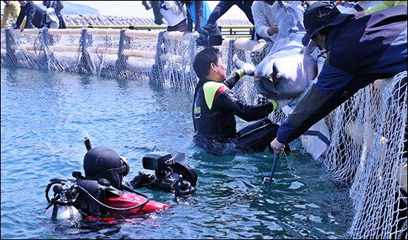
Return of Theme Park Dolphins (continued)
Supreme Court confirms District Court’s decision (March 2013)
  Confiscation of all Pacific Land dolphins to be returned to the ocean
  Fine of KRW 10 million (approx. USD 9,000)
  Director and senior officer granted 2-year stay of execution and 120 hours of community service
By the time of the Supreme Court’s order, 7 of 11 dolphins had died
Remaining Issues
  Total cost of release expected at KRW 7.5 billion (approx. USD 670,000)
  Cost of training to be fundraised by Korean Animal Welfare Association
  Health of dolphins during the drawn-out court processes

Slide 6
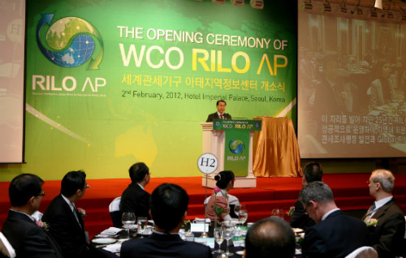
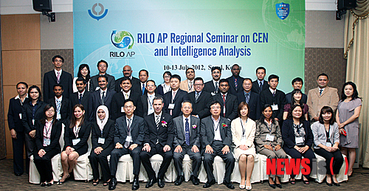
Efforts of the Korean Customs
RILO WCO AP (Regional Intelligence Liason Office of the World Customs Organization for the Asia-Pacific): Korean Customs Service (February 2012)
  Technical assistance and capacity-building efforts: RILO AP Regional Seminar on Customs Enforcement Network and Intelligence Analysis (July 2012)
  Encourage members to sign information exchange agreements
  Improve information exchange and quality of information
  Regional operation to assess country-specific intelligence and enforcement needs

Slide 7
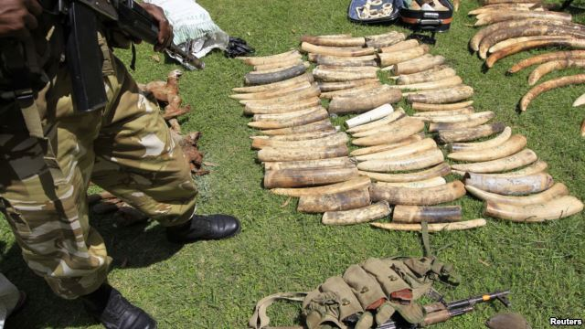
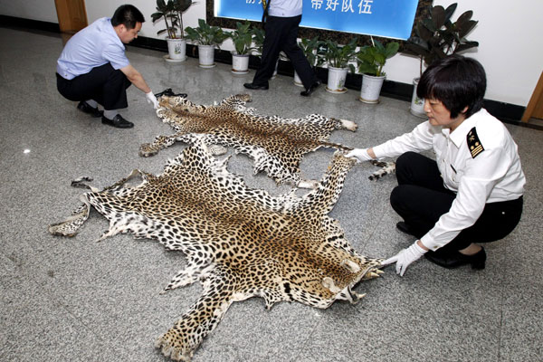
Operation Cobra: Successful case of international cooperation against illegal wildlife trade
An international, intelligence-driven operation aimed at dismantling organized wildlife crime syndicates
  By whom: Police, customs and wildlife officers from Asia, Africa and the United States
  For how long: One month (January 6 – February 5, 2013)
  Doing what: Sharing of investigation information in real time among countries and a concerted response by law enforcement agencies of implicated countries and partnering institutions to curtail rampant wildlife crime
Notes:
BEIJING — An international crackdown on wildlife crimes involving countries in Asia, Africa and the United States is claiming a significant victory. Chinese authorities say they took the lead in a broad effort to curb wildlife poaching.
A cross-border crackdown on wildlife crimes has resulted in hundreds of arrests and seizures of banned wildlife specimens, marking the first international effort led by China to reduce illicit trade in endangered species.
Between January 6 and February 5, the United States and countries in Africa and Asia cooperated in the operation code-named COBRA that specifically tried to dismantle wildlife crime syndicates.
Steven Galster is director of the Bangkok-based Freeland Foundation, an anti-trafficking organization that supported operation Cobra with research and information on wildlife crime it had collected over several years.
“China came out and actually was the government that proposed a joint operation,” he noted.
During the operation officials seized some 6,500 kilograms of elephant ivory, 2,600 live snakes, 22 rhino horns, and 1,500 kilograms of shatoosh, made from the down hair of an estimated 10,000 Tibetan antelopes.
China’s Foreign Ministry spokesperson Hong Lei spoke about the success of the operation in a briefing with reporters Monday.
He said the Chinese government is paying great attention to the protection of wildlife, including elephants. Hong Lei said while some people turn a blind eye to China’s efforts, the operation yielded significant results.
Demand from China has resulted in a huge increase in illegal wildlife poaching of endangered species in Africa. In 2011 an estimated 44 tons of illegal ivory was seized world wide, representing the deaths of thousands of elephants. Earlier this month the country of Gabon announced that poachers had killed 11,000 elephants there since 2004. Similarly, African wild rhinos used to number in the hundreds of thousands; there are less than 30,000 alive today.
Asian and African governments have been making efforts to link police, customs and wildlife officers from around the world to better combat smuggling and poaching networks. The latest operation involved law enforcement personnel from Africa’s Lusaka Agreement Task Force, Thailand, India, Vietnam, Indonesia and China.
While Operation Cobra targeted poachers, Steven Galster says China’s government is also trying to reduce demand from Chinese buyers.
“They’re targeting folks that are going overseas, naturally those that are going to go work in Africa,” he said.
The illegal wildlife trade totals $8 billion to $10 billion annually, drawing poachers and smugglers to profit from the killing of endangered species. With Chinese investment and trade with Africa soaring, sustaining the impact of Operation Cobra will be the next challenge for Asian and African nations.

Slide 8










Operation Cobra (continued)
International Coordination Team (ICT) chaired by China and based in Bangkok
  Office of China National Interagency CITES Enforcement Coordination Group (NICECG)
  Lusaka Agreement Task Force (LATF)
  Nepal Police (Representing SA-WEN)
  South African Police Service
  Indian Wildlife Crime Control Bureau
  Indonesian Police
  Vietnam Environmental Police
  Royal Thai Police
  Association of Southeast Asian Nations Wildlife Enforcement Network (ASEAN-WEN)
  U.S. Fish and Wildlife Service (USFWS)
  Regional Intelligence Liaison Office for Customs in Asia-Pacific (RILO A/P)

Slide 9
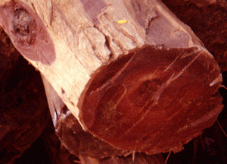
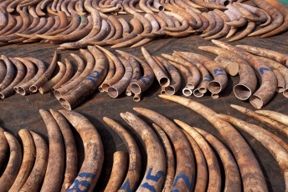
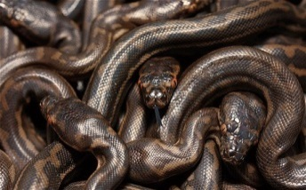
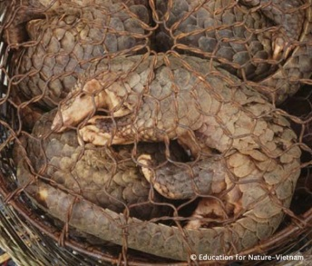
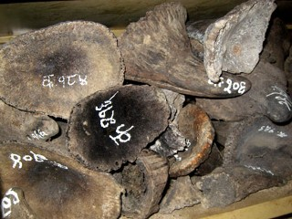
Operation Cobra (continued)
Seizures made:
  42,000kg of red sander wood
  6,500kg of elephant ivory
  1,550kg of shatoosh (from approximately 10,000 Tibetan antelopes)
  2,600kg of live snakes
  324 hornbill beaks
  102 pangolins
  800kg of pangolin scales
  22 rhino horns
  4 rhino horn carvings
  10 tiger and 7 leopard trophies
  31kg of elephant meat
  Claws and teeth of protected field animals and plant spieces
  Assorted equipment (fire arms and ammunitions) also recovered

Slide 10

Operation Cobra (continued)
Proposed in 2012 by:
Office of NICECG and ASEAN-WEN
Organized by:
China, US, South African, ASEAN-WEN, SAWEN and LATF
Assisted by:
World Customs Organization,
CITES Secretariat and INTERPOL
Participated by:
Botswana, Cambodia, Cameroon,
China, Congo, Democratic Republic of Congo, Gabon, India, Indonesia, Kenya, Laos, Malaysia, Mozambique, Nepal, Singapore, South African, Tanzania, Thailand, Uganda, US, Vietnam and Zambia
Information provided by:
FREELAND Foundation (Information on wildlife crime)
Financially supported by:
US Fish and Wildlife Service’s African Elephant Conservation Fund, Royal Thai Police, China Wildlife Conservation Association and FREELAND Foundation (with in-kind contributions by participating countries)
Targets of seizure:
Species under serious threats (big cats, elephants, rhinos, pangolins and great apes, etc.)

Slide 11
Thank You
For any questions or further information, contact sinawe@kic.re.kr

