Slide 1
Implementing the Salvador Declaration
Effectively utilizing the UN standards and norms on crime prevention and criminal justice
Prepared for the PNI workshop at the
21st UN Commission on Crime Prevention and Criminal Justice
Vienna Monday 23 April 2012

Slide 2
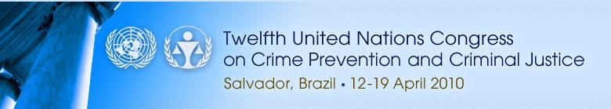
THIS PRESENTATION
Highlights the valuable work that the PNI has been doing in respect of the Salvador Declaration paragraphs that deal with effective utilization of the UN standards and norms on crime prevention and criminal (OPs 1-4, 33-35, 43-44, 48-49, 51-52).
These paragraphs urge Member States to
strengthen public-private partnerships in preventing and countering crime
take measures to promote wider education and awareness of the UN standards and norms in crime prevention and criminal justice
promote appropriate training of officials entrusted with upholding the rule of law
effectively use UN standards and norms in penitentiary administration
reinforce alternatives to imprisonment such as community service and restorative justice.
Notes:
This presentation reviews what PNI member institutes have done during the previous year in respect of the effective utilization of the UN standards and norms on crime prevention and criminal justice as guiding principles in designing and implementing fair, humane and accountable national crime prevention and criminal justice policies, laws, procedures, programmes and systems.
The Salvador Declaration (OPs 1-4, 33-35, 43-44, 48-49, 51-52) recognizes that an effective, fair and humane criminal justice system is based on the commitment to uphold the protection of human rights in the administration of justice and the prevention and control of crime, and that it is the responsibility of each Member State to update, where appropriate, and maintain an effective, fair, accountable and humane crime prevention and criminal justice system, and acknowledges the value and impact of the United Nations standards and norms in crime prevention and criminal justice.
Therefore, it urges Member States to: (1) strengthen public-private partnerships in preventing and countering crime; (2) take measures to promote wider education and awareness of the UN standards and norms in crime prevention and criminal justice; (3) promote appropriate training of officials entrusted with upholding the rule of law; (4) effectively use UN standards and norms in penitentiary administration, and (5) reinforce alternatives to imprisonment such as community service and restorative justice.

Slide 3





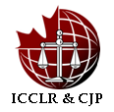







Publications, projects and research
Notes:
13 PNI members - UNAFEI, UNAFRI, ICPC, ILANUD, UNICRI, ISS, KIC, ICCLR & CJP, BIG, RWI, ISISC, NAUSS and CCLS - implemented projects, produced publications or carried out other activities in 2011 that were designed to facilitate effective use of the UN standards and norms in crime prevention and criminal justice.
This presentation is based on information collected from the PNI institutes. We have asked the representatives of the institutes to be prepared to provide you with further information on these activities, on request.

Slide 4

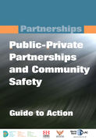

Strengthen Public-Private Partnerships
Public Private Partnership (PPP) initiative
Notes:
It has long been recognized that the complex causes of crime make it impossible for public authorities to effectively prevent crime on their own. In addition, more and more attention should be paid to alternatives to traditional forms of punishment, alternatives such as community corrections. It is therefore necessary to obtain support and cooperation from the private sector and society at large in order to achieve the goal of preventing crime and rehabilitating offenders.
The Salvador Declaration (OP 34) recognizes the importance of strengthening public-private partnerships in preventing and countering crime in all its forms and manifestations. It is through the mutual and effective sharing of information, knowledge and experience and through joint and coordinated actions, that governments and businesses can develop, improve and implement measures to prevent, prosecute and punish crime, including emerging and evolving challenges.
In Europe, UNICRI, through its Public Private Partnership (PPP) initiative, facilitated the implementation of the (PPP) Handbook in Lisbon to prevent crime and enhance overall security in urban areas. UNICRI assisted the Police Academy in Portugal in the organization of a national training course for security directors of the business sector in order to ensure that the business community develops its security strategies on the basis of the inputs provided by national authorities.
Meanwhile, UNICRI published the PPP Handbook in order to promote the establishment of Public-Private Partnerships to Protect Vulnerable Targets, and the “PPP Principles – Review of Activities and Findings”, which identified some basic principles to promote public-private partnerships worldwide.
In Canada, the ICPC, along with the World Bank and the Bogota Chamber of Commerce, published in 2011 a book entitled “Public-Private Partnerships and Community Safety: Guide to Action”, which offers good suggestions on how to build a strong public-private relationship in order to prevent crime and enhance community safety.

Slide 5

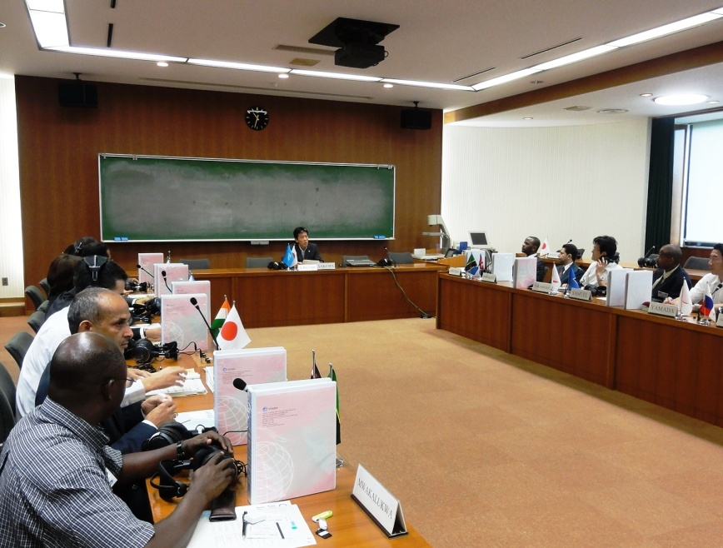
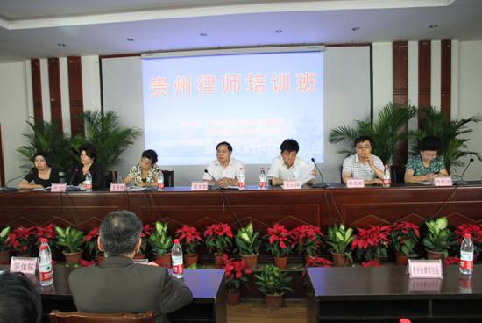
Promoting Wider Education and Awareness
International Training Course
Books and training for lawyers
Notes:
Crime is a social phenomena and has its root in society, and criminal law might be considered a reflection of corporate or societal morality. Therefore, in order to effectively prevent crime we need a social culture that is favorable for the development of a culture of respect for the rule of law. The Salvador Declaration (OP 43) urges member states to take measures to promote wider education and awareness of the United Nations standards and norms in crime prevention and criminal justice in order to ensure such a culture. PNI members made noticeable contributions in this area by holding various training courses.
In Asia, UNAFEI organized an International Training Course on “Measures to Secure Protection and Cooperation of Witnesses and Whistle-blowers,” and organized a training programme regarding the response to corruption and related acts, including the investigation, prosecution and adjudication of these acts.
Also in Asia, the CCLS undertook a project on Challenges of Criminal Justice to Fundamental Principles in China in 2011, which was sponsored by the National Fund for Social Sciences and designed to examine what changes adoption of UN standards and norms would bring to Chinese criminal justice and how Chinese criminal law should be adjusted to these changes.
Meanwhile, the CCLS, in cooperation with the Law Institute of Guizhou Academy of Social Sciences, held a three-day training course in Guiyang, Guizhou province, regarding the two regulations on use of evidences issued by the Supreme People’s Court and Supreme People’s Procuratorate of the PRC for lawyers.
CCLS also published a book entitled “Study on Application Standard of the Death Penalty”, which examines UN standards and norms concerning the death penalty and inmates sentenced to the death penalty, and studies how to implement these standards and norms in capital cases.

Slide 6


Promote Wider Education and Awareness
Training for lawyers and report
Capacity development activities on the application of UN Standards and Norms for justice sector institution in Africa, Asia and Europe
Notes:
In Africa, UNAFRI, in cooperation with the Centre for Capital Punishment Studies, organized training for lawyers in Uganda on mitigation in capital sentences, and a report is in print on the preliminary findings from fourteen of thirty sampled countries, revealing challenges in the implementation of UN Minimum Standards for the Treatment of Offenders in Africa.
In China, the RWI, in cooperation with the China National Prosecutors College, helped to
* increase knowledge and skills among provincial prosecutor trainers in China to design and deliver high quality human rights courses,
* design E-learning courses on human rights that have been developed and incorporated among the obligatory online courses at the National Prosecutors College,
* develop 13 separate and needs-based courses in human rights at provincial prosecutor colleges and
* design common standards for evidence handling for 20 different types of crimes in the Haidian District People’s Procuratorate.
Meanwhile, the RWI cooperated with the Haidian District People’s Procuratorate in Beijing, and helped to improve the skills of juvenile justice prosecutors at Haidian District People’s Procuratorate. In this connection, the RWI also developed and implemented working guidelines on juvenile justice reform based on best practices through specialized training on international juvenile justice issues.
In the Middle East and North African region, the RWI in cooperation with judicial training academies and other justice sector institutions conducted training to promote enhanced structures, knowledge and skills in relation to human rights teaching. This contributed to a review by the judicial training academies in six Arab countries of legislation and jurisprudence in relation to international human rights standards. The RWI also provided training to a number of police officials from Tunisia at two workshops on a human rights based approach to policing during elections.

Slide 7

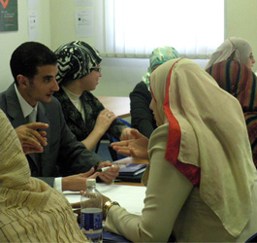
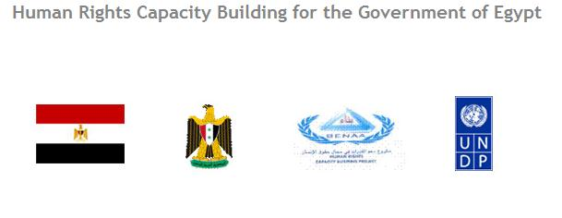
Promote Appropriate Training of Officials
Forensic training course
Notes:
The realization of the rule of law to a considerable degree relies on law enforcement officials and other legal professions. Therefore, the Salvador Declaration (OP 44) calls on member states to promote appropriate training of officials entrusted with upholding the rule of law, including correctional facility officers, law enforcement officials and the judiciary, as well as prosecutors and defense lawyers, in the use and application of UN standards and norms. PNI member institutes have responded positively to this challenge.
In the Middle East, NAUSS held jointly with Qatar University a forensic training course on “Digital Criminal Guide for Cyber-terrorism Crime "in Qatar, and a training course about the art of negotiation and crisis management, held jointly with the Ministry of Interior in Yemen in 2011.
UNICRI also carried out tailor-made training courses on the request of member states regarding human rights and the correctional system, for Brazilian judiciary personnel, and for the Egyptian, Algerian and Italian Correctional Services.

Slide 8

Use UN Standards and Norms in Penitentiary Administration
A pilot prison reform project in six countries
South Sudan project on prison reform (2006 – present)
Cooperation in Latin America to improve treatment of prisoners in accordance with human rights standards.
Notes:
The Salvador Declaration (OP 48) recognizes that the penitentiary system is one of the key components of the criminal justice system, since imprisonment, traditionally and currently, is the main response to crime. The Declaration urges member states to use the United Nations standards and norms for the treatment of prisoners as a source of guidance in the development or updating of national codes of penitentiary administration.
In Africa, UNAFRI provided expertise at the Association of Correctional Services of Africa (ACSA), the Prison Rehabilitation and Welfare Association (PRAWA), the International Corrections and Prisons Association (ICPA), and Prison Fellowship International (PFI) African chapter, in order to mobilize support, impart skills and improve visibility to create a potential for further coalitions in corrections focusing on implementation of standards.
With PRAWA, a pilot prison reform project in six countries for Prison Reform Intervention in Africa (PRIA) is an on-going UNAFRI project for data collection essential for policy development.
In Latin America, the United Nations Latin American Institute for the Prevention of Crime and the Treatment of Offenders (ILANU in cooperation with D) has been engaged in regional efforts to improve treatment of prisoners in accordance with human rights standards. A comparative regional study was conducted on criminal justice and penitentiary systems, providing examples of good practices in Latin America. The study contributed to increased understanding of international prisons standards among correctional officers, the judiciary and national human rights institutions in Argentina, Bolivia, Brazil, Chile, Colombia, Costa Rica, Cuba, Ecuador, El Salvador, Guatemala, Honduras, Mexico, Nicaragua, Panama, Paraguay, Peru, The Dominican Republic, Uruguay and Venezuela. From 2006 to present, ICCLR has been conducting a South Sudan project on prison reform and has made noticeable achievements.

Slide 9
Use UN Standards and Norms in Penitentiary Administration
Human rights capacity develpment programmes for the correctional services in Kenya and Indonesia
Reform of punishment sponsored by Ministry of Justice
of the PRC
Notes:
In Kenya, the RWI contributed to the development of the capacity of the Kenya Prisons Service to manage its human rights training needs, and offered support for the adoption of (1) a human rights training curriculum at the Kenya Prisons Staff Training College, to make human rights training integral to the education of all correctional officers, and (2) a strategic plan for the Human Rights Office of the Kenya Prisons Service; and a strategic plan for the Kenya Prisons Staff Training College.
In South-East Asia, the RWI in cooperation with the Directorate General of Corrections (DGC) of Indonesia carried out various activities aimed at enhancing the capacity to operate prisons in compliance with human rights standards and professional prison management principles. These activities contributed to the incorporation of key elements of the UN Standard Minimum Rules for the Treatment of Prisoners into the draft Indonesian correctional services bill. Systematic work was carried out at seven model prisons in order to comply with provisions of the Standard Minimum Rules that still have not been met. This work also helped to improve the ability of instructors at the Indonesian Correctional Services Academy to train cadets in human rights and prison management according to international standards.
In Asia, the CCLS began a study on reform of punishment in China in 2011, which was sponsored by the Ministry of Justice of the PRC and designed to review present penal systems and its enforcement systems in China and offer suggestions on how to implement the relevant UN standards and norms in prisons in China.

Slide 10
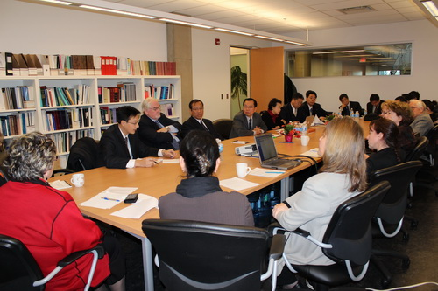
Alternatives to Imprisonment
International Training Course International Corrections Program
Project on Draft Community
Corrections Law
Notes:
Empirical studies have shown that imprisonment, especially short-term imprisonment, might not be the best answer to some crimes or the best way to rehabilitate some offenders, and it might create barriers for offenders to reintegrate into society. Moreover, for some people, prisons are schools where they can learn more criminal skills. Appreciating this point, governments have made noticeable efforts to develop and use alternatives to imprisonment, both for economic and utilitarian reasons.
The Salvador Declaration (OP 51) stresses the need to reinforce alternatives to imprisonment, including community service, restorative justice and electronic monitoring and support rehabilitation and reintegration programmes, including those to correct offending behavior, and educational and vocational programmes for prisoners.
In 2011, UNAFRI, on Kenya’s request, conducted an evaluation study on Community Service Orders in Kenya, for data generation; advisory service, and capacity-building. Community Service Orders in Kenya were identified as good practice, replicable elsewhere.
The ICCLR and the CCLS began in 2011 a China-Canada Legislation Development Project for Community Corrections, which was sponsored by the Canada International Development Agency (CIDA) and designed to offer a draft Community Corrections Law for the Chinese Legislature. The CCLS is currently preparing a draft text, which is expected to be finished by the end of May 2012.
Meanwhile, the ICCLR has been conducting an international corrections program since 1991 including needs assessment of prisons, conducted in Botswana, Uganda, Zambia, and Swaziland.
The CCLS published a book, Comparatives Study on Community Corrections, which introduces experiences of implementing community corrections in development countries, reviews pilot programs in China and offers suggestions on how to promote and perfect present provisions.

Slide 11
How can the PNI further help member states?
As a response to requests by members states PNI
can provide services, such as exchange of
information, research, training and specialized
education, development of training tools and
guidelines, etc

